Slide 1

LPA 6th Grade Transition Night
What can a teen wolf expect?
March 4, 2019

Slide 2


Your LPA
Support Team
Principal Mrs. Traci Hemingway
Assistant Principal Mrs. Elizabeth Haas
Assistant Principal Mrs. Jessica McCool
Assistant Principal Mr. Donald Hoessler
Counselor Mrs. Sarah Vance
Dean Mr. Keith Cromwell

Slide 3


We are your cheerleaders!
The start of middle school is an exciting time, but can also be filled with jitters and nervous energy for students and parents.
Be confident in LPA’s team! The administrators, dean, teachers, counselors, and staff are all committed to supporting your student so they experience a strong work ethic, positive attitude, independence, and social, emotional and academic success!

Slide 4
Clubs Offered
Math Counts – for students enrolled in grades 6-8 – open club – only 11 students in the club offered the opportunity to participate in a Chapter Competition – This club meets before school 7:30-8:00
STEM Club – for students enrolled in grades 6-8 – open club – participated in the Science Olympiad Competition in February at Embry Riddle Aeronautical University– Club begins in September – meets Monday’s from 3:00-4:00.
Odyssey of the Mind – for students enrolled in grades 6-8 – 7 students form one team - Odyssey of the Mind is an international creative problem-solving program that engages students in their learning by allowing their knowledge and ideas to come to life in an exciting, productive environment. Students participate in a regional competition in March – after school club
Cross Country Club – for students enrolled in grades 6-8 – Participates in district level Cross Country Meets throughout the county on Wednesday’s after school - Meets Tuesday and Thursday from 3:00-4:00
Drama Productions – for students enrolled in grades 6-8 – students audition for the production – meets afterschool for practice and dress rehearsal

Slide 5
Sports Offered at LPA
LPA Volleyball – (Fall Sport) offered to students enrolled in grades 6-8 - this is a school and district ran sport - students tryout for the team – practices are after school with games on Tuesday’s and Thursday’s
LPA Basketball – (Winter Sport) offered to students enrolled in grades 6-8 - this is a school and district ran sport - students tryout for the team – practices are after school with games on Tuesday’s and Thursday’s
LPA Dance Team – (Fall and Winter) offered to students enrolled in grades 6-8 - this is a school and district ran sport - students tryout for the team – practices are after school with games on Tuesday’s and Thursday’s

Slide 6
Sports Through SJMSAA
Sports ran through the Parks and Recreation Department – not LPA
  Football
  Baseball
  Softball
  Soccer
  Tennis
  Cheer
  Golf

Slide 7

Communication with teachers
We welcome your communication. Email communication is the preferred method. Due to the busy nature of the school day our teachers will need time to respond. Please allow up to 48 hours.
All teachers provide an auto reply which alerts parents as to times email is checked.
To request a meeting with an individual teacher via email for an appointment.
The Sixth grade team generally meets as a team when there is a parent conference. This helps with getting a better understanding of what is going on with the student in all of his/her classes.

Slide 8
How do I stay informed?
We have a 6th grade webpage for general information on the LPA Website. http://teachers.stjohns.k12.fl.us/lpa-grade6/
Online textbooks are available for all core classes and the links are located on the LPA website under Links for Students.
Usernames and passwords are the same for all accounts
Teachers use Schoology in lieu of a class website.
Students will use Schoology to view upcoming activities, tests, and important class information.
Home Access Center (HAC) allows parents and students to view grades online. Students use the same username and password for all of their textbooks and HAC.
Notes:
Sarah Vance

Slide 9
Planners/Schoology
Organization is the key to success! A planner is given to each student at the start of school.
Students should record all homework and assignments in the student planner.
Parents will want to check their child’s planner and Schoology on a daily basis to assist the child in the development of organizational skills
Notes:
Sarah Vance

Slide 10

Organization = Success
Write assignments in planner
Check Schoology site daily
Put homework in the correct class folder/notebook
Study Buddy, have other student’s phone numbers to call for help or questions about homework or assignments.
Do homework when assigned
Schedule on inside of locker
A “study area” at home with limited distractions – TV, cell phone, video games, etc.
Plenty of sleep and a good breakfast
A great attitude
Notes:
Sarah Vance

Slide 11

Homework
Homework is to be expected for students in grades 6th -8th grade
Each night, students will have approximately sixty minutes of homework
Your child will have a Schoology account
There is also a calendar that will show when each assignment and upcoming activity is for the student for all their classes
If your child says he/she has no homework:
TRUST BUT VERIFY
Notes:
Sarah Vance

Slide 12

HOWL Time
Each Wednesday, students have HOWL time built into their schedule in order to receive extra assistance in a given class, enrichment opportunities, time to complete an assessment.

Slide 13

Supplies
The 6th grade supply list will be posted on the LPA website at the end of the year.
Supplemental supply requirements will be posted on each teacher’s Schoology page if necessary.
If your child has art or 7th grade math, there will be additional supplies
If your child has band or chorus, there will be additional fees for these classes.

Slide 14
Schedule
LPA students take 7 courses each day
Wednesday – We will have HOWL time where there will be time for remediation and enrichment
Students report to homeroom each day at 8:30am for important morning announcements.

Slide 15

6th Grade Course Requirements
Core Subjects:
Language Arts, Math, Science, World History
(standard or advanced)
Required Non-Core
Advanced Reading or Intensive Reading – full year
Physical Education – full year
Optional Non-Core
Band 1 – full year
Exploring 2D Studio Art – full year
Chorus – full year

Slide 16
Is there a summer reading requirement?
Yes. All students at Liberty Pines Academy have summer reading options. This information will be posted on the LPA website by the end of April.
Please check the website for specific due dates.
This will be a jump start to our Journey Through Genres for the first quarter

Slide 17

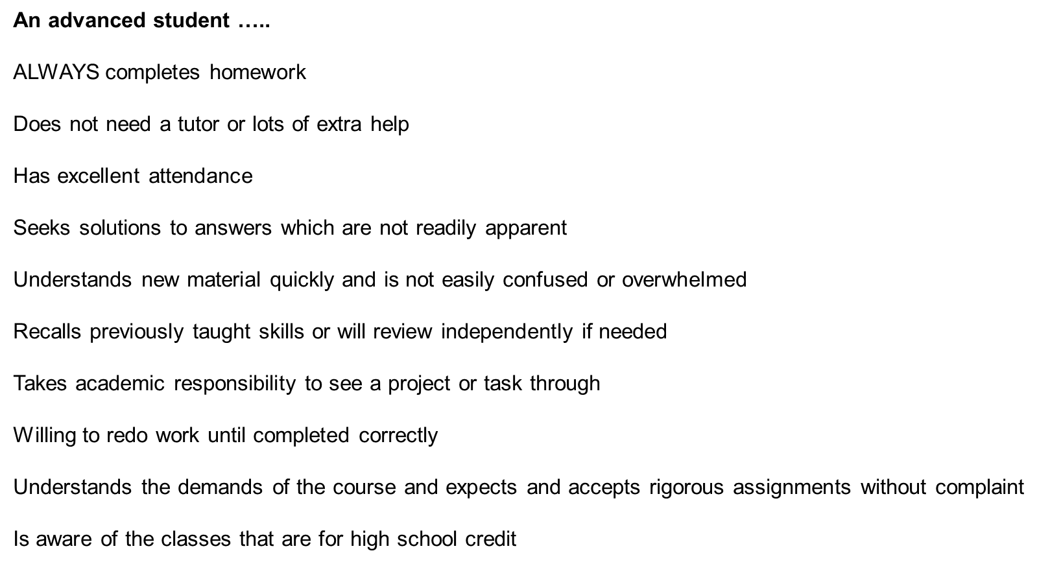

Slide 18

What are the math options for my child?
LPA offers a variety of options for middle grades students depending on their individualized learning path for math:
  6th Standard/Advanced
  7th grade Standard/Advanced/ Pre-Algebra/Algebra 1 Honors
  8th grade Pre-Algebra/Algebra 1 Honors/Geometry Honors
Algebra I (Honors)- has EOC which is 30% of their final grade
(High School course)
Geometry (Honors)-has EOC which is 30% of their final grade
(High School course)
All 6th grade students will be placed in 6th grade standard or 6th advanced math math based on their Math FSA scores from 4th and 5th grade, final math grades from 5th grade

Slide 19
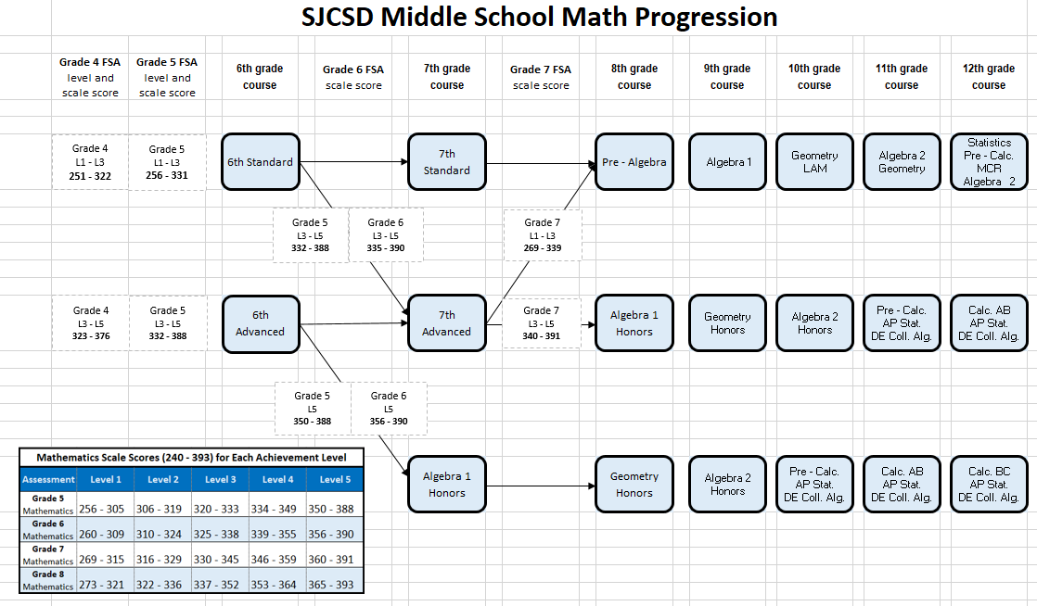
Criteria for Placement in Mathematics

Slide 20


Slide 21
Physical Education
All 6th grade students take a full year of P.E.
Students cannot wear their school clothes to participate in physical education.
Every student must have a PE uniform
Uniforms can be purchased at a discount rate if ordered by the end of the school year (shorts and a t shirt). The online order form will be available on the LPA website. These uniforms are distributed during PE class at the beginning of the school year.
Students must wear sneakers
Students are given adequate time to change at the beginning and end of class

Slide 22
Physical Education Curriculum
Semester 1 Semester 2
Grade 6: Fitness Gymnastics / Dance
Grade 7: Team Sports Comprehensive PE
Grade 8: Individual / Dual Sports Comprehensive PE

Slide 23

Advanced Reading – Adventures in Reading
All 6th grade students who are not in intensive reading will be in the Advanced Reading elective.
This year long course will help students increase reading fluency and endurance through advanced integrated experiences in the language arts. Students will also have the opportunity to earn essential digital tool skills through this class in word processing, multi-media and communications.
Students conduct novel studies and enhance their learning through comprehension strategies and
study skills.

Slide 24
Band 1
Band is a year-long commitment that meets every day
Parent permission is required to participate in Band
Students perform for Night of the Arts and other opportunities throughout the school year
Instruments may be rented or purchased at a cost to the parents
Practice = Homework, students are expected to practice at least 20 minutes a day on their instrument
Band Boosters support band students through a “Fair Share” fee of $80

Slide 25
Chorus
Students will develop beginning vocal technique skills, critical and creative thinking skills, and an appreciation of music from around the world and through time. Public performances may serve as a culmination of specific instructional goals. Students may be required to attend and/or participate in performances outside the school day to support, extend, and assess learning in the classroom. There is a $20 fee.

Slide 26
2 Dimensional Art
Students explore media and techniques used to create a variety of 2-D artworks through developing skills in drawing, painting, printmaking, and collage. Students practice, sketch, and manipulate the structural elements of art. Investigation of artworks from Western and non-Western cultures provide a means for students to expand their understanding and appreciation of the role of art in global culture.
Student artists use an art criticism process to evaluate, explain, and measure artistic growth in personal or group works. This course incorporates hands-on activities and consumption of art materials.

Slide 27

LPA Expectations
Be Respectful
Treat others with respect; follow the Golden Rule
Use good manners, not bad language
Be tolerant and accepting of differences
Respect school property and other’s belonging
Words do hurt – be considerate of other’s feelings
Be Responsible
Do what you are supposed to do
Persevere, keep on trying and always do your best
Take ownership of your learning success
Don’t make excuses – accept the consequences for your actions
Be Ready to Learn
Come to class prepared with supplies, books, all completed homework and assignments and a positive attitude
We are a Character Counts! School

Slide 28
Hot topics for 6th graders…..
Sixth Graders are responsible for their academic progress. This shift is important for an independent learner.
Please partner with your child and have them show you how to log on to HAC and Schoology and have them explain to you about their classwork, homework, and test scores. Your child will learn how to access these important tools the first couple weeks of school.
Please check HAC and Schoology daily

Slide 29



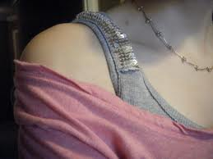
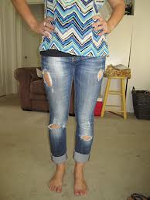
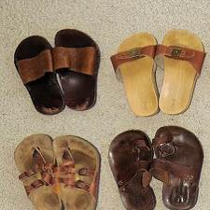
Dress Code
Shorts & Skirts can’t be shorter than fingertip length
Leggings may be worn with a shirt that is fingertip length
No tank tops or sleeveless shirts smaller than 3” wide
No shirts that reveal midriffs or open backs
No lace or shear shirts with tanks underneath
No shirts off the shoulder that show straps
No holes, rips, or tears in jeans showing skin
No backless shoes

Slide 30
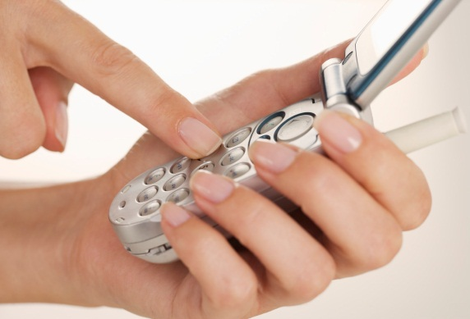
Cell Phones
Must be OFF and kept in locker.
Students may not use the cell phone during the day.
A phone will be taken if it is out during the day.
  First Violation: Phone confiscated, corrective consultation & phone returned at end of day by the Dean
  2nd Violation: Parent must meet with Dean for conference
  Subsequent Violations: Progressive Discipline Followed

Slide 31
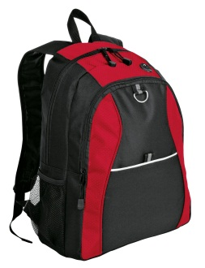
Backpacks
Backpacks may be carried between classes – please stress the importance of load capacity with your child
No rolling backpacks are allowed without a doctor’s note – these cause a trip hazard during hall change

Slide 32

Summer Venture
We will hold a summer camp for rising 6th grade students again this year. More information will come at the end of the school year. Hold the dates 9:00-1:00:
Monday and Tuesday – July 15th and 16th
OR
Thursday and Friday – July 25th and 26th

Slide 33
Residency Verification
This year this process is online for St Johns County Schools
This will take place early April

Slide 34
Course Verification Forms
Your child will bring home their course verification form on Tuesday, March 5, 2019. On this form you will see:
Core class recommendations – ELA, Math, Science, Social Studies – write any class questions you may have on the form, sign the bottom, and return it to your child’s homeroom teacher
Elective registration form – please number your choices 1 to 3 with 1 being the class you want the most

Slide 35

Thank you for coming tonight.
We are confident your children will have a successful transition to the 6th grade.
Our experienced team is ready to help your child become a successful and independent learner!

